Slide 1
Autoencoder
20180313
投資程設科 劉義瑋

Slide 2
Outline
Introduction
Autoencoder
Simple Autoencoder
Deep Autoencoder
Deep Convolutional Autoencoder
De-noising Autoencoder
Pre-training for DNN

Slide 3
Autoencoder
Unsupervised learning
LeCun, 1987; Bourlard and Kamp, 1988; Hinton and Zemel,1994
Hinton, Geoffrey E., and Ruslan R. Salakhutdinov. "Reducing the dimensionality of data with neural networks." Science 313.5786 (2006): 504-507

Slide 4
Unsupervised Learning
Clustering & Dimension Reduction
K-means
PCA
Autoencoder
Generation
Autoencoder
GAN

Slide 5
K-means
將資料分為 K 群
Scikit-learn K-means
K = 3
https://dotblogs.com.tw/dragon229/2013/02/04/89919
GIF

Slide 6
PCA
Principal component analysis (PCA)
0_PCA.ipynb
More
Scikit-learn PCA
Scikit-learn Matrix Decomposition
http://www.nlpca.org/pca_principal_component_analysis.html

Slide 7
Autoencoder

Slide 8
Simple Autoencoder
encoder
Input layer
Output layer
784
784
Bottle neck
32
X
^
Code
X
1_Basic_Autoencoder.ipynb
decoder

Slide 9
Deep Autoencoder
encoder
Input layer
Output layer
784
784
128
Bottle neck
128
64
64
32
Code
^
X
X
1_Basic_Autoencoder.ipynb
decoder

Slide 10
Clustering
比較在 MNIST 上 PCA, Simple Autoencoder, Deep Autoencoder 降維到 2 維的分佈效果
動手試試看 2_Clustering.ipynb
其他視覺化的方法
t-SNE: 將高維降到低維度（2, 3 維）視覺化，通常會透過其他降維方式將原本的 data 降到一個較小的維度（如 64 維），再透過 t-SNE 視覺化
Could K-means clustering on the output of t-SNE ?
Scikit-learn t-SNE
2_t-SNE.ipynb

Slide 11
Deep Convolutional Autoencoder
UpSampling
Conv2D
Input
Conv2D
MaxPooling
UpSampling
Conv2D
Conv2D
MaxPooling
Conv2D
MaxPooling
Conv2D
UpSampling
Conv2D
28x28x1
14x14x16
7x7x8
4x4x8
8x8x8
14x14x16
28x28x1
3_Conv_Autoencoder.ipynb

Slide 12
Unpooling
https://leonardoaraujosantos.gitbooks.io/artificial-inteligence/content/image_segmentation.html

Slide 13
Deconvolution
GIF
Deconvolution is Convolution!
https://leonardoaraujosantos.gitbooks.io/artificial-inteligence/content/image_segmentation.html

Slide 14
Plot
比較三種 Autoencoder 的效果
4_Plot.ipynb
original
simple
deep
convolution

Slide 15

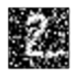
De-noising Autoencoder
X
X’
^
X
Add
Noise
5_De-noising_Autoencoder.ipynb

Slide 16
Pre-training for DNN
100
1024
2048
4096

Slide 17
Pre-training for DNN
2048
4096
4096

Slide 18
Pre-training for DNN
1024
2048
2048
4096

Slide 19
Pre-training for DNN
100
1024
2048
4096

Slide 20
Generation ?

Slide 21
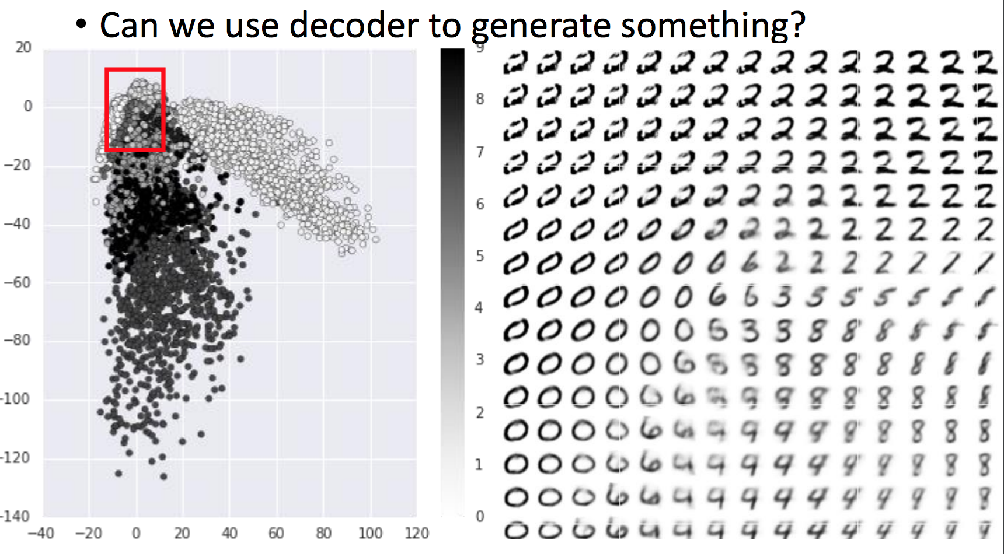
Generation ?
http://speech.ee.ntu.edu.tw/~tlkagk/courses/ML_2017/Lecture/auto.pdf

Slide 22
To be continued…

Slide 23
Reference
http://speech.ee.ntu.edu.tw/~tlkagk/courses_ML17_2.html
https://blog.keras.io/building-autoencoders-in-keras.html
https://github.com/Rentier/keras-autoencoder

